Slide 1

Department of BES-II
BASIC ELECTRICAL & ELCTRONIC CIRCUITS (BEEC)
Course Code: 23EC1203
Topic: Series Resonance
Session – No. 7

Slide 2



AIM OF THE SESSION
To familiarize students with the basic concept of series resonance.
INSTRUCTIONAL OBJECTIVES
This Session is designed to:
Define resonance and its significance in a series RLC circuit.
Derive the formula for resonant frequency and impedance & various parameter behavior.
LEARNING OUTCOMES
At the end of this session, you should be able to:
Compute the resonant frequency and quality factor of a series RLC circuit.
Analyze the effect of resistance, inductance, and capacitance on resonance.

Slide 3
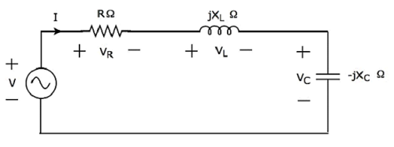
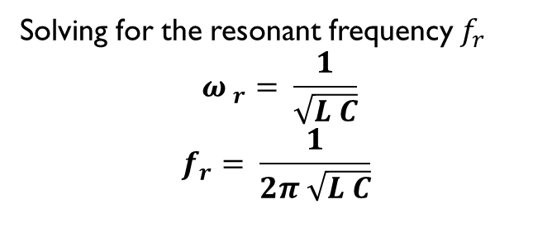
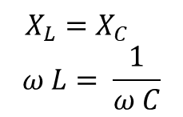
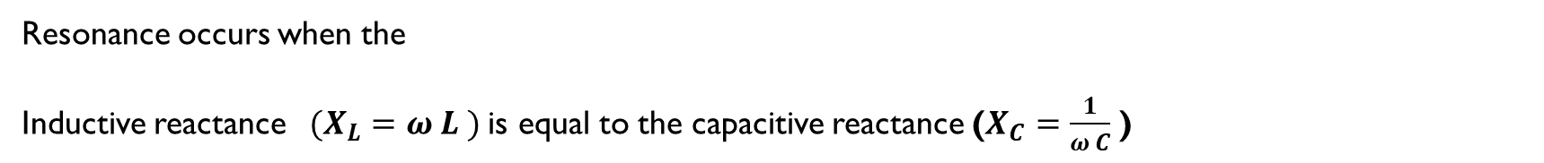
Resonance in RLC Series Circuit
Resonance occurs when the
Inductive reactance$(X_{L}=ω L )$ is equal to the capacitive reactance ($X_{C}=\frac{1}{ω C}$ )
$$X_{L}=X_{C }$$
$$ω L= \frac{1}{ω C}$$
Solving for the resonant frequency $f_{r}$
$${ω }_{r}= \frac{1}{\sqrt{L C}}$$
$$f_{r}= \frac{1}{2π \sqrt{L C}}$$

Slide 4
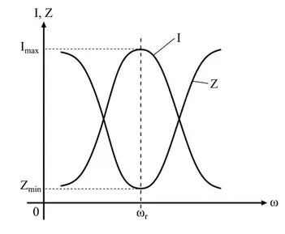
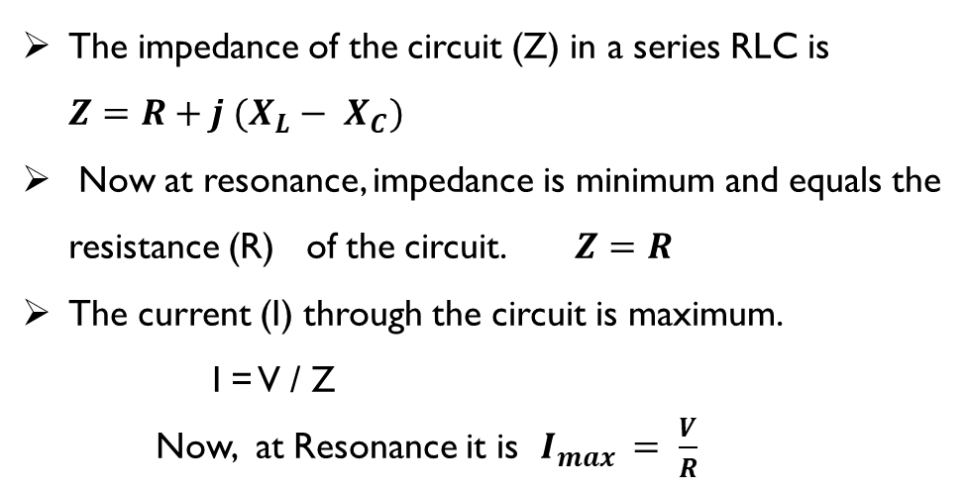
Impedance and Current of Circuit at resonance
The impedance of the circuit (Z) in a series RLC is ${Z=R+j (X}_{L}− X_{C})$
Now at resonance, impedance is minimum and equals the resistance (R) of the circuit. $Z=R$
The current (I) through the circuit is maximum.
I = V / Z
Now, at Resonance it is $I_{max }= \frac{V}{R}$

Slide 5
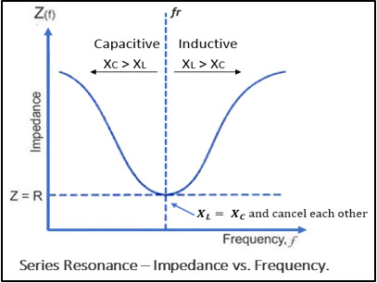
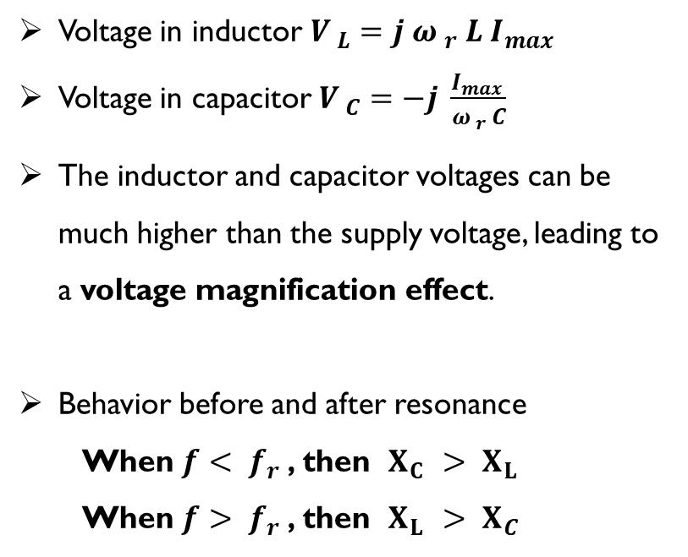
Voltages of L & C at resonance
Voltage in inductor $V_{ L}=j {ω }_{r} L I_{max }$
Voltage in capacitor $V_{ C}=−j \frac{I_{max }}{{ω }_{r} C}$
The inductor and capacitor voltages can be much higher than the supply voltage, leading to a voltage magnification effect.
Behavior before and after resonance
  When ${f< f}_{r}$ , then $X_{C }> X_{L}$
  When ${f> f}_{r}$ , then $X_{L }> X_{C}$

Slide 6

Quality Factor ( Q Factor) & Bandwidth
$$Q= \frac{{ω }_{r} L}{R} = \frac{1}{{ω }_{r} C R}$$
The quality factor (Q) represents the sharpness of resonance:
A higher Q means a narrower bandwidth and a sharper resonance.
The Bandwidth ( ∆ f ) is given by $∆ f= \frac{{f }_{r}}{Q}$
The circuit behaves like a band-pass filter, allowing signals near ${f }_{r}$ ​while attenuating others.

Slide 7
Applications of Series Resonance
Radio tuning circuits (selecting specific frequencies)
Oscillators and filters (frequency-selective networks)
Impedance matching in RF systems
Inductive heating and wireless power transfer

Slide 8
Problems on Resonance in RLC Series Circuit
1. A series RLC circuit has L=50mH and C=20μF. Calculate the resonant frequency of the circuit.
2. A series RLC circuit has R=10Ω, L=0.1 H, and C=50μF. What is the impedance of the circuit at resonance.
3. A series RLC circuit with R=5Ω, L=0.2 H, and C=10μF is connected to an AC source of 50V. Determine the maximum current at resonance.
4. For a series RLC circuit with R=15Ω,L=30mH, and C=10μF, calculate the quality factor (Q) of the circuit at resonance.
5. A series RLC circuit has R=20Ω,L=0.1H, and C=25μF. At resonance, the circuit is connected to an AC source 10V. Find the current through the circuit & Determine the voltage across the inductor and capacitor.

Slide 9
SELF-ASSESSMENT QUESTIONS
In an RLC circuit, what does "R" represent?
Resistor
Reactance
Resonance
Real power
2. In which of the following circuit, current lags voltage ?
RC
RL
Both
None

Slide 10
SELF-ASSESSMENT QUESTIONS
3. What is the Phase angle of Voltage across Resistor?
90 degrees
-90 degrees
Zero degrees
None
4. In which of the following circuit, current leads voltage ?
RC
RL
Both
None

Slide 11
TERMINAL QUESTIONS
Describe the concept of resonance in a series RLC circuit.
Calculate the resonant frequency for a given RLC circuit with specific values of L and C.
Explain why the impedance of a series RLC circuit is minimum at resonance.
Determine the significance of the quality factor (Q) in resonance circuits.

Slide 12

THANK YOU
Team – BASIC ELECTRICAL & ELCTRONIC CIRCUITS (BEEC)

